Slide 1
Human Effects & Symptoms of Pollution
A data story about the real effects of human made pollution.
And the global effort that needs to be achieved soon.

Slide 2
Methodology & Introduction
Tools and resources used:
Dataspell.
Our world in data archives.
Maddison Project Database.
Coding:
Time series analysis using the Auto-ARIMA package.
MatPlotLib for visualisations.
This project will discuss the growing problem of pollution, energy consumption, and the consequences of ignoring the warning signs of those farsighted enough to see the clouds gathering over 126 years ago.

Slide 3
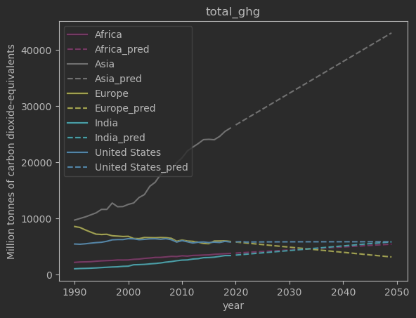
Pollution levels - The Data
Asia pollutes more than Europe, US, India, and africa at 2020. But is not entirely to blame for this production.
If this level of pollution does not slow down rapidly the consequences are dire for us all.
Solutions cannot be delayed any longer due to the associated lags of implementing them.

Slide 4
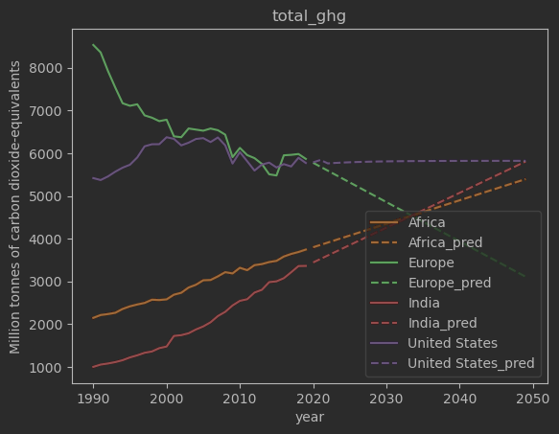
Pollution - Continued
Europe is set to half its total greenhouse emissions by 2050.
Developing countries pollution levels are growing the fastest.
The United States could be doing much more given how developed
its economy is.

Slide 5
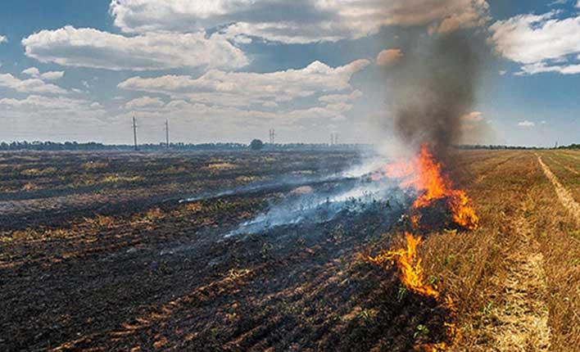
Pollution - The Symptoms
Summers are getting increasingly hotter and record breaking temperatures are being made every year.
More water needs to be consumed in order to combat this leading to more resources to replenish them.
Industrial agriculture is depleting soil nutrients faster than they can come back in certain . regions.
Image source:
https://www.istockphoto.com/photo/fire-burns-stubble-on-the-field-destroy-summer-gm600993640-103314527

Slide 6
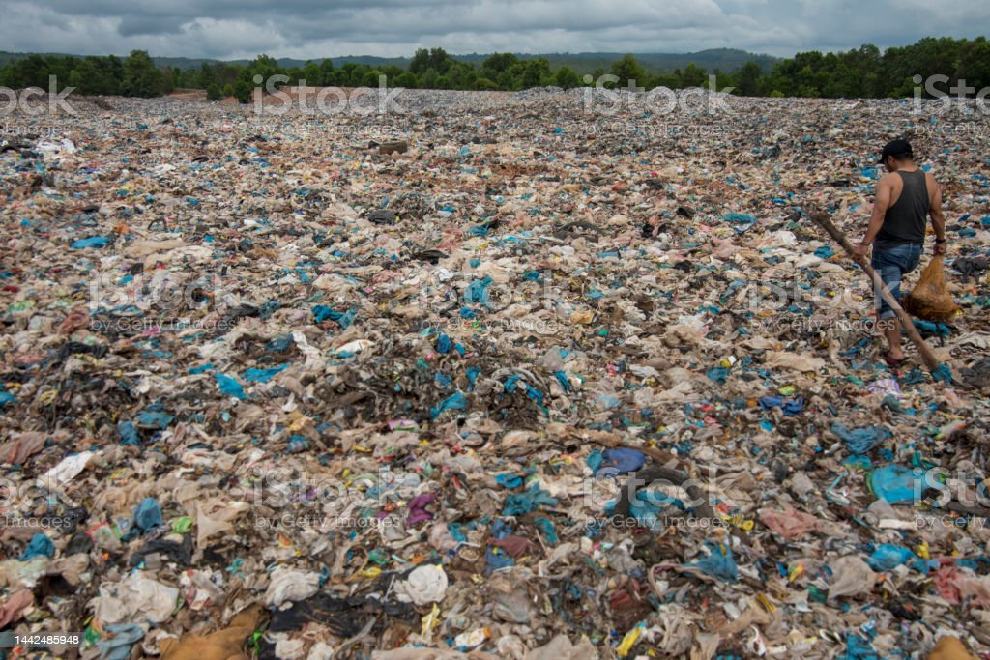
Pollution - The Symptoms
The main gases produced in landfills, ammonia, sulfides, methane, and carbon dioxide are of most concern. Many who have to filter through the trash to get by have no PPE, and are often young.
A study in New York found that there is a 12% increased risk of congenital malformations in children born to families that lived within a mile of a . hazardous waste landfill site.
Image source:
https://www.istockphoto.com/photo/garbage-in-landfills-gm1442485948-481820840?phrase=landfill&searchscope=image%2Cfilm

Slide 7
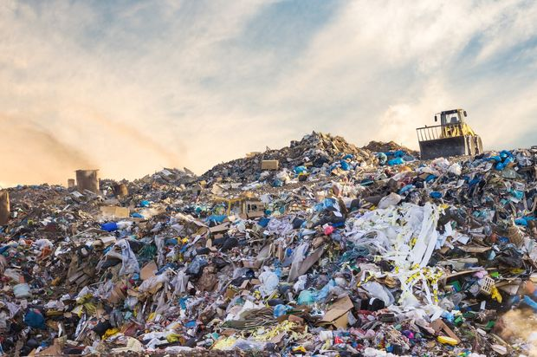
Pollution - The Symptoms
Results from a study showed that 78% of participants living closer to the landfill site indicated serious contamination of air quality evident from bad odours linked to the landfill site.
Illnesses such as flu, eye irritation and weakness of the body are frequently reported.
Image source:
https://www.istockphoto.com/photo/garbage-pile-in-trash-dump-or-landfill-pollution-concept-gm845816364-138463573

Slide 8
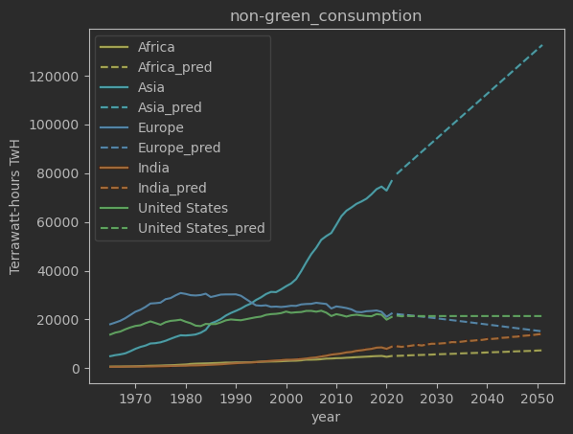
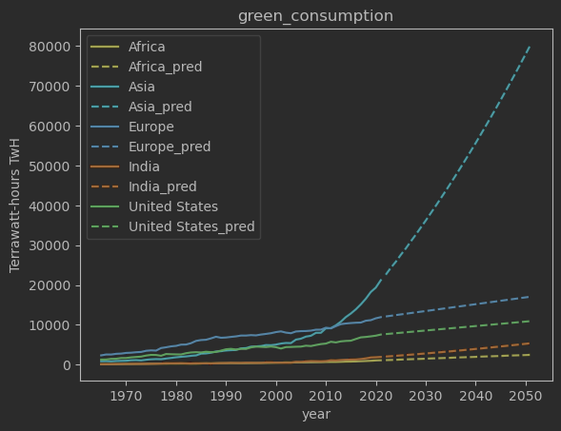
Energy Consumption
The thorium cycle can fully recycle actinide wastes
After a few hundred years, the waste from a thorium reactor can be less toxic than the uranium ore.
Up to two magnitudes less nuclear waste that has a shorter half life in 100’s compared to 1000’s
Liquid fluoride thorium reactors are designed to be meltdown proof

Slide 9
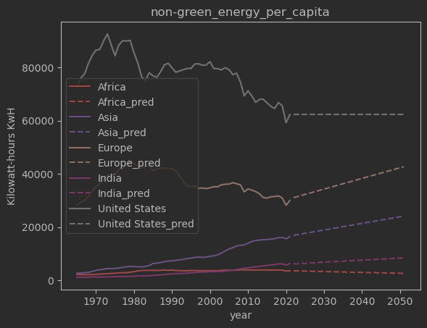
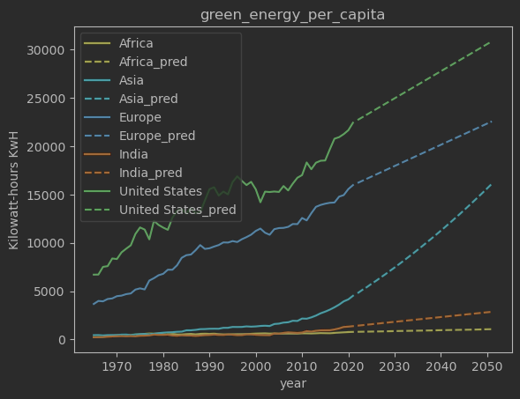
Energy - Per Capita

Slide 10
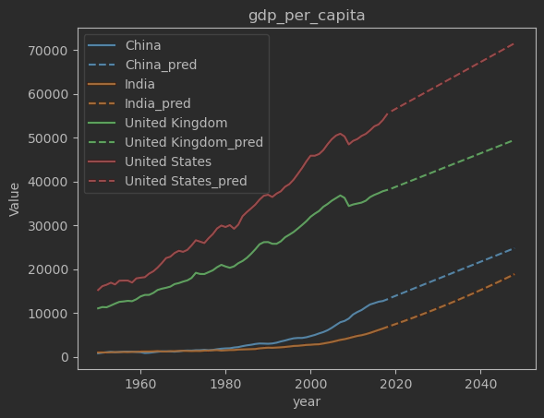
Energy - Green Investments & GDP
Types of investment include:
Energy production,
Pollution controls,
Green transportation,
Waste reduction,
Sustainable agriculture and aquaculture,
Water investments.

Slide 11
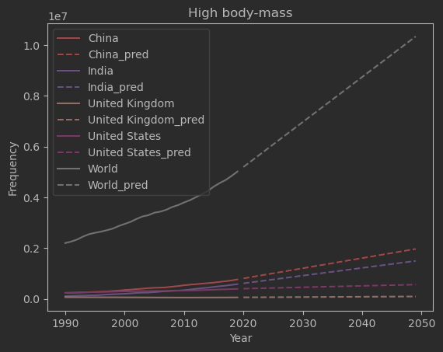
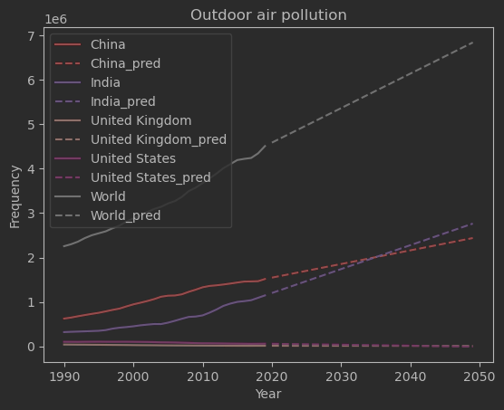
Pollution - The Deaths
Global disease burden takes into account not only years of life lost to early death, but also the number of years lived in poor health.
Air pollution not only takes years from peoples’ lives, but also had large effect on quality while they’re still living.

Slide 12
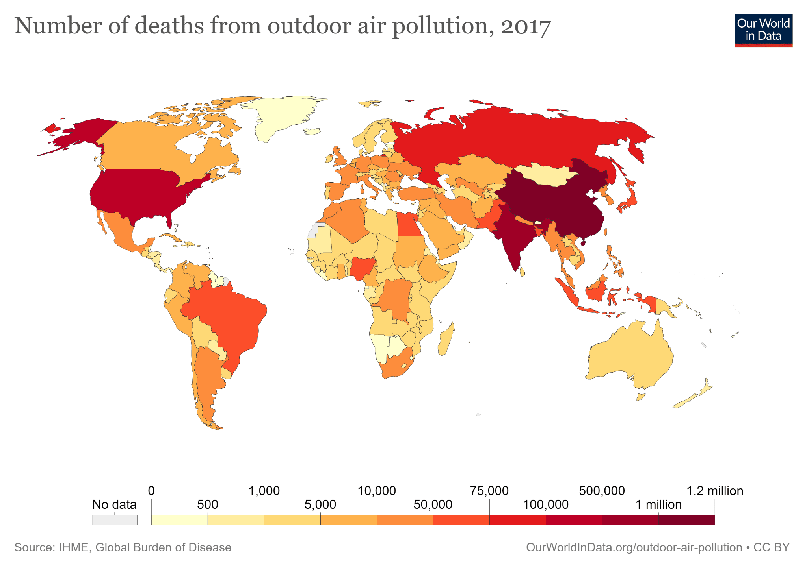
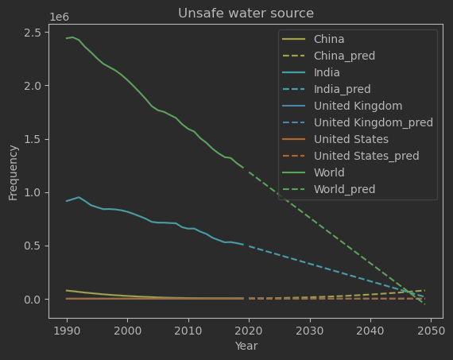
Pollution - The Deaths
Over 2 billion people live in water stressed countries, which is expected to be exacerbated in some regions as result of climate change and population growth.
While the most important chemical risks in drinking water arise from arsenic, fluoride or nitrate, emerging contaminants such as pharmaceuticals, pesticides, and microplastics generate public concern

Slide 13
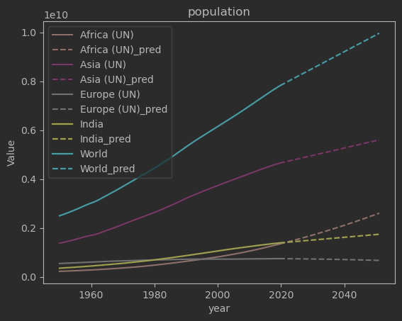
Population Growth
40%
25%
Africa
World
20%
Asia
-3%
Europe
10%
India

Slide 14
Summary
Pollution is outpacing population mostly due to developing nations moving toward industrialisation.
The pollution caused is having massive health consequences for many who don’t even have access to clean drinking water. They have to shoulder the burden for our lifestyles which has lots of ethical implications.
Solutions exist today but are struggling to be implemented due to being unprofitable.
Global disease burden can be attributed to air pollution.
People should have the right to a clean world and access to safe drinking
water.

Slide 15
Limitations and Appendices
Limitations:
The scope of this project is so huge that every section could in itself easily be a 20 minute presentation to only discuss this for 2-3 mins each is a difficult task and something that could have been done better.
Appendices:
Would have love to expand each topic into its own 10 min presentation discussing more depth and going into ethics more.
Expanding the use of the datasets to incorporate every metric (there was about 130 total reduced to about 10).
Using more data to incorporate the broader spectrum I would have liked to things like how developed a country is, their exports vs imports, air quality and comparing that to deaths from air pollution etc.
And much much more!
Any Questions?

Slide 16
Sources
https://www.scientificamerican.com/article/china-invests-546-billion-in-clean-energy-far-surpassing-the-u-s/
https://www.mass.gov/doc/health-environmental-effects-of-air-pollution/download
https://www.rug.nl/ggdc/historicaldevelopment/maddison/releases/maddison-project-database-2020
https://ourworldindata.org/economic-growth
https://ourworldindata.org/air-pollution
https://ourworldindata.org/co2-and-greenhouse-gas-emissions
https://ourworldindata.org/energy
https://ourworldindata.org/world-population-growth
https://frankiecancino.medium.com/forecasting-with-auto-arima-in-python-7d74bc61f0c3
https://alkaline-ml.com/pmdarima/modules/generated/pmdarima.arima.auto_arima.html
https://www.ncbi.nlm.nih.gov/pmc/articles/PMC6617357/
https://www.who.int/news-room/fact-sheets/detail/drinking-water
Links to all information used in the gathering and presenting process.

